Slide 1
Course Title - Web System Engineering
Topic Title - Basics of JavaScript
Presenter’s Name - M ArunKumar
Presenter’s ID - IARE11151
Department Name - CSE ( Artificial Intelligence, and Machine Learning )
Lecture Number - #
Presentation Date - 14/02/2025

Slide 2
Intro JavaScript
Now that we know how to add and beautify web content using HTML
and CSS, we next have to make this content live and interactive using
JavaScript programming.
JavaScript is the brain behind all the beauty of the
web content.
JavaScript defines
- how user interaction will be handled,
- what actions will happen, and
- what will be the next state of the application.

Slide 3
Structure
Introduction to JavaScript
Building blocks of JS
More about functions
Arrays
Working with DOM
JavaScript (JS) is a light-weight, cross-platform, object-oriented computer programming language, which was developed to add logic and behavior to the web.
So how does JS fit in here?
What if we have some JavaScript associated?
And firstly, how do we associate JavaScript into the HTML/CSS code?

Slide 4
Building blocks of JS
Variables
let : Recommended way of defining variables that remain
valid in the block in which it is defined, and its value can be changed
and reassigned.
let name;
let age;
let num1,num2,num3;
const : containing value is constant and will not undergo change.
const pi=3.14;
var : This is the traditional way of defining variables in JS, which is not block scoped but function scoped. var dummy;

Slide 5
Scope
There are two kinds of scope – global scope and local scope
Any variable which is declared outside any function is accessible anywhere
in the code, even in the functions and is in the global scope.
const global = 'Hi! I am Global';
Local variables are accessible only in a specific part of your code. The local scope can be of two types as follows:
Function scope: When a variable is declared within a function, it is accessible only within the function.
Block scope: When a variable is declared using the const or let keyword, within a block of curly brace ({}), it is accessible only within that curly brace.

Slide 6
Summarizing the differences between let, const, and var
Feature | let | const | var
Scope | Block-scoped (only accessible within the block it is defined) | Block-scoped (only accessible within the block it is defined) | Function-scoped (accessible within the function where defined)
Re-declaration | Can be re-assigned, but cannot be re-declared in the same scope | Cannot be re-assigned or re-declared once defined | Can be re-declared and re-assigned within the same scope
Hoisting | Hoisted, but not initialized (temporal dead zone) | Hoisted, but not initialized (temporal dead zone) | Hoisted and initialized with undefined
Re-assignment | Can be re-assigned new values after initialization | Cannot be re-assigned after initialization | Can be re-assigned new values after initialization
Best Use Case | Use for variables whose values may change over time | Use for constants (values that should not change) | Use only when backward compatibility is required (older code)
Global Object Property | When declared in the global scope, it does not attach to the global object | When declared in the global scope, it does not attach to the global object | When declared in the global scope, it attaches to the global object (e.g., window in browsers)

Slide 7
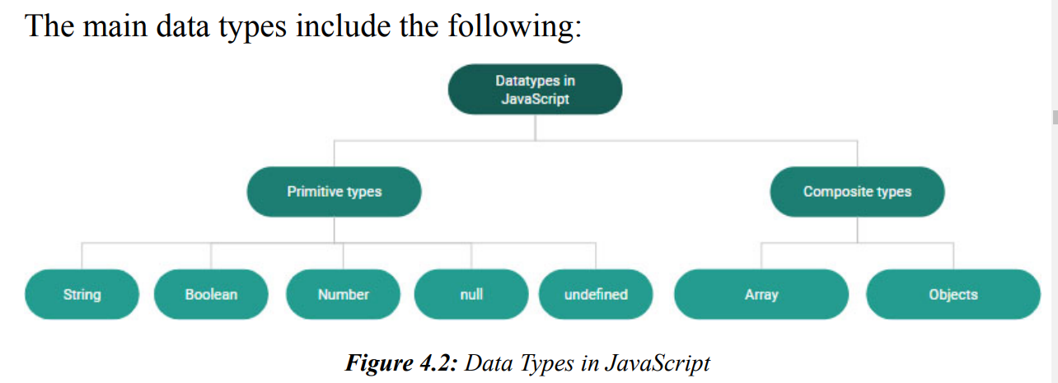

Slide 8
Null is used for any unknown value. It has a single special value null, which indicates nothing", empty or value unknown. let yearOfManufacture = null;
Undefined: Another single special value which indicates that the value is not assigned. It can also be used to assign the value undefined as follows explicitly:
let num1;
console.log(num1); //undefined
let num2=10;
num2=undefined;
console.log(num2); //undefined
Object: This is complex data for handling complex data structures, including data of different types. A single object can include data of different types as follows:
var person={
name:"Peter",
age :24,
designation:"Software Engineer", Allocated: true}

Slide 9
JavaScript Data Type conversion:
Automatically by JavaScript itself -
String(): The global method String() can convert numbers, booleans, literals, expressions, dates to strings.
String(false) // returns "false"
String(Date())// returns current date in string format
ToString(): This method does the conversion on any number and converts to string:
(498).toString() // "498"

Slide 10
Operators
2++; // Unary Operator
2 + 3; // Binary Operator
(4 > 3) ? true : false; //Ternary Operator
Arithmetic Operators:
Assignmentoperators:
Comparison operators:
Logical operators:
Comments ( Single & Multi line comments)
Conditional statements:
if..else statements , switch case statements:

Slide 11
Function
People repeating the same code again and again, which raises the need for putting the common code in a single place and reuse it.
A function is a code block that is designed to work together to perform a specific task.
function keyword is used to explicitly define and
give a name to the function as the name, calculateDistanceTravelled
Finally, return a value from the function to indicate the end of execution flow
Function invoking:
document.write("You have travelled : " + calculateDistanceTravelled(startPos, currentPos) + " KM ");
Parameter Vs Arguments of function, . JavaScript passes arguments using the passby-value approach:

Slide 12
Arrays
Arrays are a list of values that are represented with an index starting from 0.
let cities= ["Hyderabad", "NewYork", "Calgary"];
console.log(cities[0]); // Hyderabad
console.log(cities[1]); // NewYork
Accessing the array elements
Calculating the length of the array - array.length
Using the map method: The map method calls the function
let num=[10,20,30];
square= num.map((n,index)=> {
return n*n;
});
console.log(square);//[100,400,900]
Notes:
for each element and returns an array of the elements modified by the function

Slide 13
Using reduce method - for each element of the array but returns an accumulated response
Using filter method - checks for a specific condition for each element

Slide 14
Working with DOM
DOM (Document Object Model)
The Document Object Model (DOM) is a programming interface for
HTML and XML documents. It represents the page so that programs can
change the document structure, style, and content. The DOM represents the
document as nodes and objects.
Using JavaScript, if we have to interact with the page content, it will be
through the DOM.
What can all be done?
Change the HTML elements in the page
Make changes to the HTML attributes in the page
Make changes to the CSS styles in the page
Add/remove HTML elements and attributes
Handle/emit HTML events in the page
DOM nodes have properties and methods - to modify the nodes styling properties
that allow you to modify the nodes styling properties and behavior, handling
different actions on the nodes.

Slide 15
Thank You

